Slide 1
PART- A ~ EMPLOYABILITY SKILL
COMMUNICATION SKILL
Session - 2023-24
CBSE CLASS
IX & X
[ IT - 402
AI - 417
FIT- 417 ]
TOPIC TO BE COVERED
What is Communication
Various Methods of Communication
Communication Cycle
Importance of Feedback
Barriers of Communication
7C’s of Communication Skill

Slide 2
COMMUNICATION SKILL

Slide 3
Define Communication?
Communication comes from the Latin word communicare, which means to share.
Thus, Communication is exchanging or sharing messages or information between two or more individuals or within a group to reach a common understanding.

Slide 4
What are the different methods of Communication?
There are different methods of communication, which include
non-verbal,
verbal and
visual.

Slide 5
Non-verbal communication

Slide 6
Non-Verbal Communication –
Non-verbal communication is the message we send to others without using any words.
In this, we send signals and messages to others, through expressions, gestures, and body postures. Maximum communication is Non-Verbal.

Slide 7
DIFFERENT TYPES OF NON-VERBAL COMMUNICATION ARE
Expressions/ Facial Expression Example, when we are happy, we express it through a smile or when we are sad we show a gloomy(उदास) face.
Posture - Example, a straight body posture is seen as confidence. Holding your head may be taken as tiredness.
Gestures or Body Language - Example, raising a hand may mean asking a question. Biting nails show nervousness.
Touch - Example, a firm handshake shows confidence. Sports coaches pat the back of the players to encourage the players.
Space - The space between two persons while communicating, generally depends on the intimacy or closeness between them.
Eye Contact - Maintaining eye contact with the person you are talking to indicates interest, whereas, looking away can make the other person feel ignored.
Paralanguage - Paralanguage is the tone of our voice, speed, and volume that makes a difference in the meaning of the communication. Speaking too fast may show excitement or nervousness. Speaking too slowly may show seriousness, sadness.

Slide 8
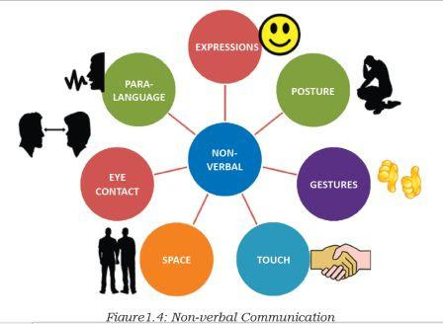

Slide 9
verbal communication

Slide 10
Verbal Communication
Verbal communication is the sharing of information by using words.
Verbal Communication is a type of oral communication in which we use sounds and words to express our thoughts and feelings.
Verbal Communication takes place in the form of speeches, discussions, presentations, and conversations.
It is what most people use as a method of communication. Verbal communication is important because if we do not use the right words, we will cause confusion and will not be able to communicate what we want.

Slide 11
Type of Verbal Communication | Examples
Oral or Spoken Communication Communication which involves talking | Face-to-face conversation: When we can see the listener- For example, group discussion, talking to family members at home, conversation with the public through speeches, etc. Talking on a phone: This is for personal and official communication. Classroom teaching, business discussion and public speeches are other examples of oral communication, where one person talks to many others at once.

Slide 12
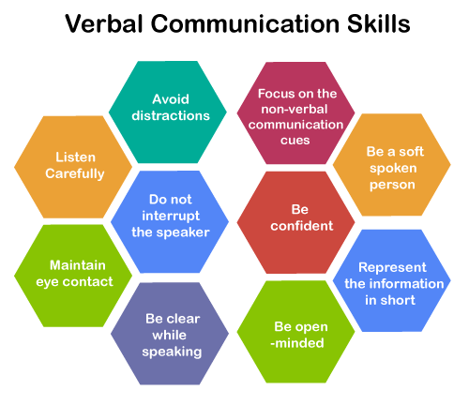
Components of Verbal Communication

Slide 13
Advantages of verbal communication
Verbal communication is easy and quick. we get a quick response. It is an easier form of communication when we have to exchange ideas.
The response we get from the audience is quick and immediate.
We can keep updating our speech according to the response we get from the audience.
It is a cheaper way of Communication. It saves money.

Slide 14
Disadvantages of verbal communication
The Cultural and lingual differences between the speaker & the listener may result in miscommunication.
It has no legal validity & is not suitable for lengthy messages.
If we use confusing and complicated words, they may be difficult to comprehend.

Slide 15
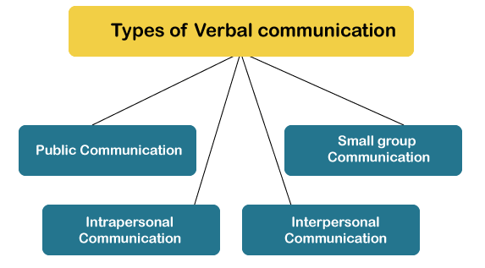

Slide 16
Written Communication: Communication that involves written or typed words. | Writing letters, notes, email, etc. SMS (Short Message Service): These can be sent through a phone to a person or a group Using email to share news, thoughts, documents and files (including photos, videos, music, etc.). Can be used to send messages to a person or to a group. Books and newspapers.

Slide 17
Components of Verbal Communication

Slide 19
Intrapersonal Communication | Silent Conversations we have with ourselves.
Interpersonal Communication | Interpersonal communication refers to communication between two or more people.
Small Group Conversation | Conversation is the way that humans have always thought together. In conversation we discover shared meaning. It is the primal human organizing tool.
Public Communication | “Public communications mean any material that is communicated to the public, either directly or through the media in print, broadcast or electronic form.”

Slide 20
Feedback
The receiver’s response or reply to the sender’s message is called feedback.
Feedback is actually the acknowledgement of a successful communication. It ensure that the complete message was delivered successfully.

Slide 21
Feedback
The receiver’s response on reply to the sender’s message is called feedback.
Feedback ensures a proper understanding between sender and receiver.
Feedback provides information about the success of the communication.
Feedback is the acknowledgment to the sender message.
When the receiver sends answers or responses through a message or information, it is called feedback.
It is especially important in a two-way communication process.

